Slide 1
Evaluating Different Methods of Random Number Generation
Alexander Bodycoat

Slide 2
What is random number generation?
The use of mathematical algorithms to produce an uninterrupted stream of output, be it digits, binary data, or any other form of information, in which one output has no correlation to any of the outputs that have come before or will follow it.
Divided into two types, pseudorandom, and true random. Pseudorandom generators are based off of known algorithms, and true random generators are based off of events and phenomena that are not possible to measure or predict in any reasonable way.

Slide 3
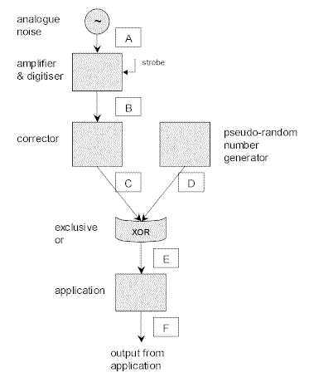
True Random VS Pseudorandom
True random generation is created from outside
sources of randomness, examples of this can be
atmospheric noise generated by the air itself or
the electricity running through a transistor.
A notable example of this include lava lamps, which
are used by the company CloudFlare in order to
provide random numbers for their encryption
methods.

Slide 4
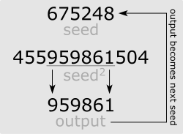
True Random VS Pseudorandom
All pseudorandom number generators are based off of mathematical algorithms instead of unpredictable events. An example of this type of random number generator is the Middle-Square method.
The Middle square method works by taking a 4-digit number, then squaring it to produce an 8-digit number. The middle four digits are then used to create the next 8-digit number, and so on.
This is a very inefficient algorithm, as the numbers
produced begin to repeat after around 750000 digits.
whereas others only begin to loop from 2^60 to
2^20000000 digits.

Slide 5
What random number generation is used for.
Random number generation is used heavily in the fields of gambling, statistics, computer simulation and cryptography/encryption, as the presence of an element that cannot be predicted is often the cornerstone of many systems.
In encryption and cryptology, unguessable random number generation is used to provide the seeds used in the encryption algorithm. A guessable pattern means that the encryption could be reverse engineered.

Slide 6
How can we tell if something is random?
Numerous methods for testing the randomness of a series of digits and the generator that produced them exist. One of the most commonly known is a series of mathematical evaluations called DIEHARD.
Diehard performs a battery of tests of a provided file of random digits and reports back on how random the series of digits appears to be.
There are no pass/fail conditions, it is up to the user to decide whether the outcome of the random number generation is acceptable for the needs.

Slide 7
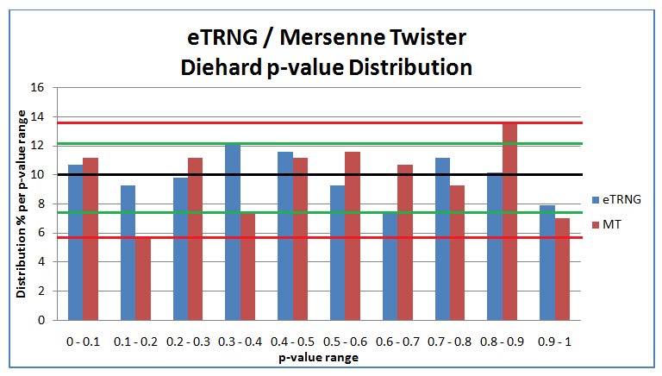
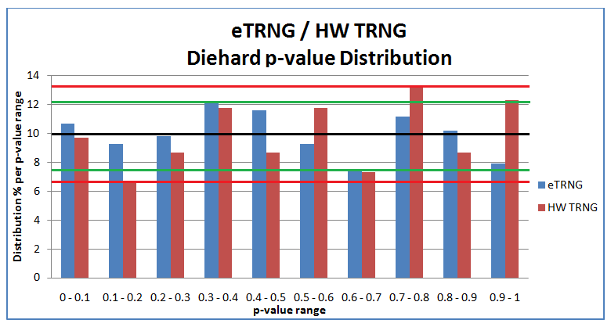

Slide 8
Testing to determine randomness.
DIEHARD is only one example of a testing suite that provides diagnostics. For this research another testing suite was used, known as RaBiGeTe.
DIEAHRD is a program for Linux systems only and as such a separate battery of tests was needed.
RaBiGeTe is much more versatile then the DIEHARD tests as it subjects the same amount of tests without having to work with a clunky command line interface.

Slide 9
Using a set of 5000 random integers produced by random.org, I used them as a set of information for testing.
The program assigns a p-value to each integer and uses its tests to determine the distribution of the various integers.
The program also creates a number of different visual representations of the testing data in the forms of graphs and tables.

Slide 10
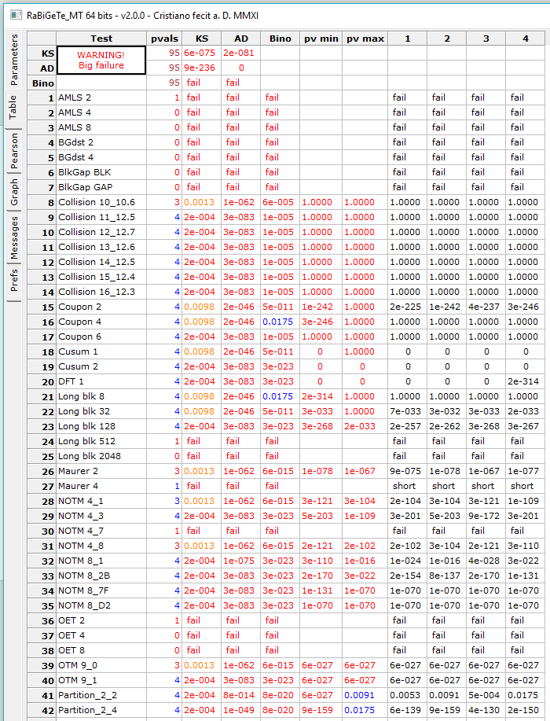
Testing 5000 Ints
This is the output I received from
my testing. As shown by the BIG
FAILURE sign in the upper corner
something is wrong with the
data I have provided to it.

Slide 11
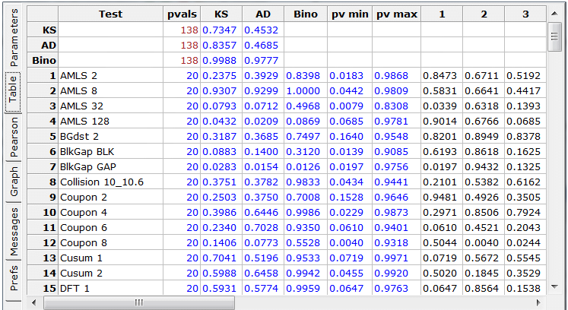

Slide 12
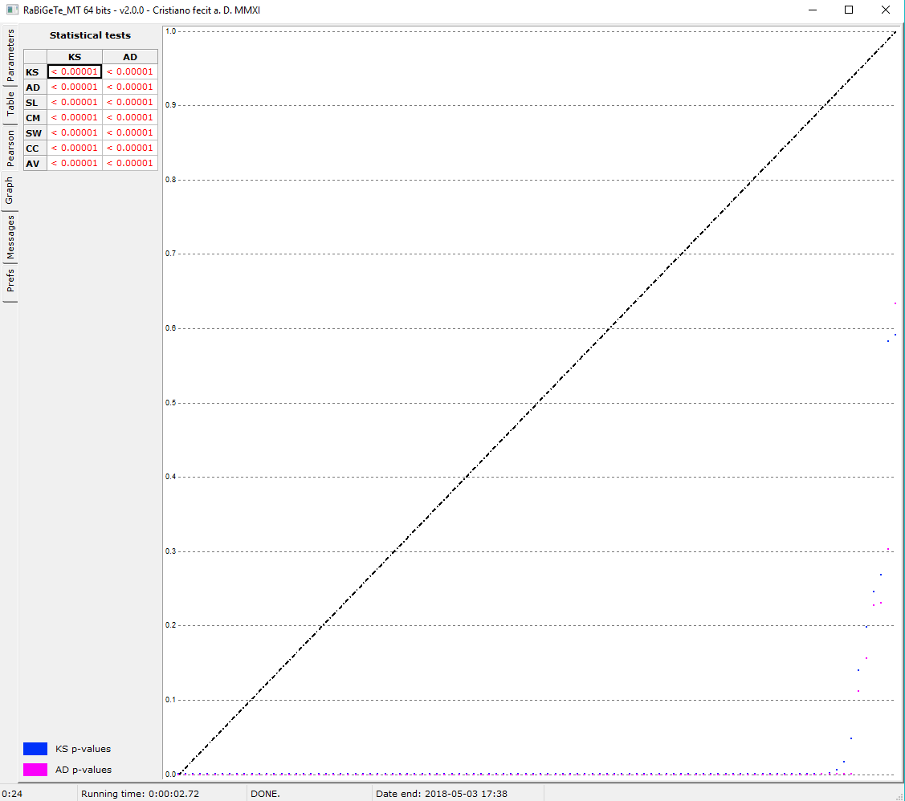

Slide 13
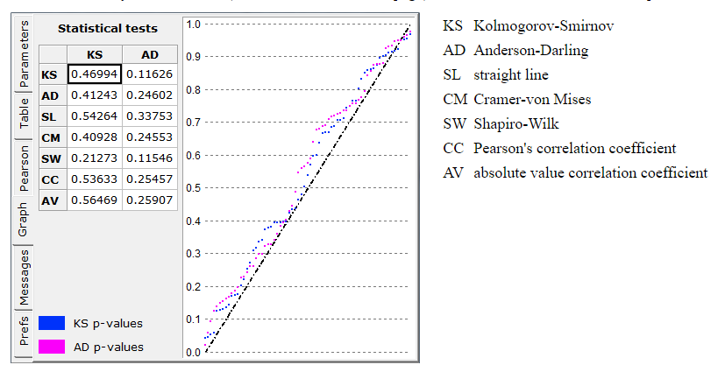

Slide 14
Conclusions
On average, random number generation provided from true random number generation methods tend to be more “Random” in their outputs then their algorithmic counterparts.

